Slide 1
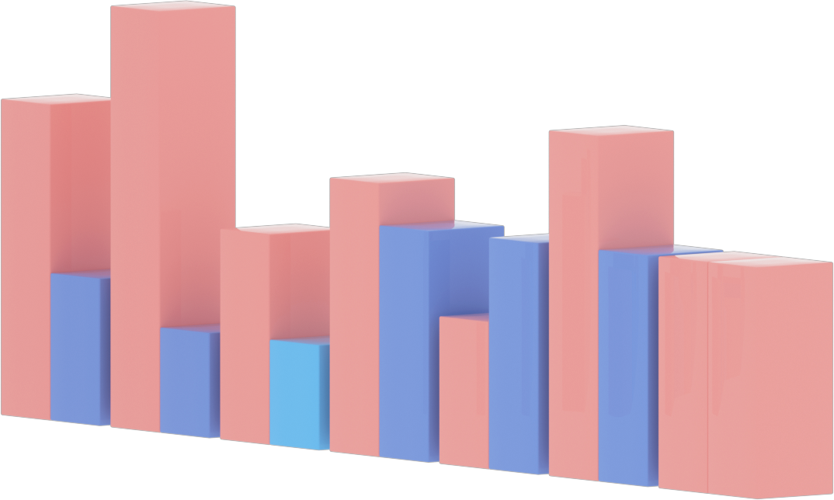
CG MINI PROJECT - GRAPH PLOTTER
GRAPH PLOTTER
CG-MINI PROJECT
BY - Darsh Jain - 17
Asjad Nirban - 36

Slide 2
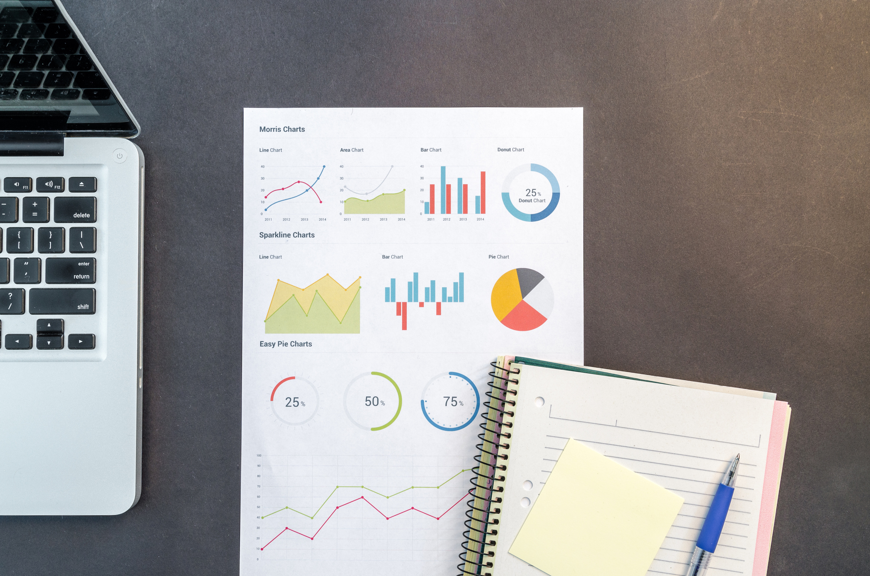
CG MINI PROJECT - GRAPH PLOTTER
INTRODUCTION
What are graphs?
Graphs are basically a pictorial way to represent complex numerical data or Statistical
Data which is not easy to convey to others. So to overcome this issue we have introduced
a program which converts the Numerical data into picture form.

Slide 3
CG MINI PROJECT - GRAPH PLOTTER
System Requirements
Any OS
C / C++ compiler
·E.g.: WINDOWS, MAC OS, and LINUX etc.)
Any C or C++ compiler with Graphic library.

Slide 4


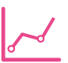
CG MINI PROJECT - GRAPH PLOTTER
DESCRIPTION
Bar Graph
Our project Aim is
to converts the big Numerical data into pictorial form and provide the graph of that data to the user.
We first ask the user to prompt the graph types which he/she requires And then the user will input statistical data accordingly
3D Bar Graph
Item 5
20%
Item 1
20%
Pie Charts
Item 4
20%
Item 2
20%
Item 3
20%
Line Charts

Slide 5

CG MINI PROJECT - GRAPH PLOTTER
IMPLEMENTATION
50
Item 5
20%
Item 1
20%
40
30
20
Item 4
20%
Item 2
20%
10
0
Item 1
Item 2
Item 3
Item 4
Item 5
Item 3
20%
Bar Graph
Pie Chart
Line Chart

Slide 6
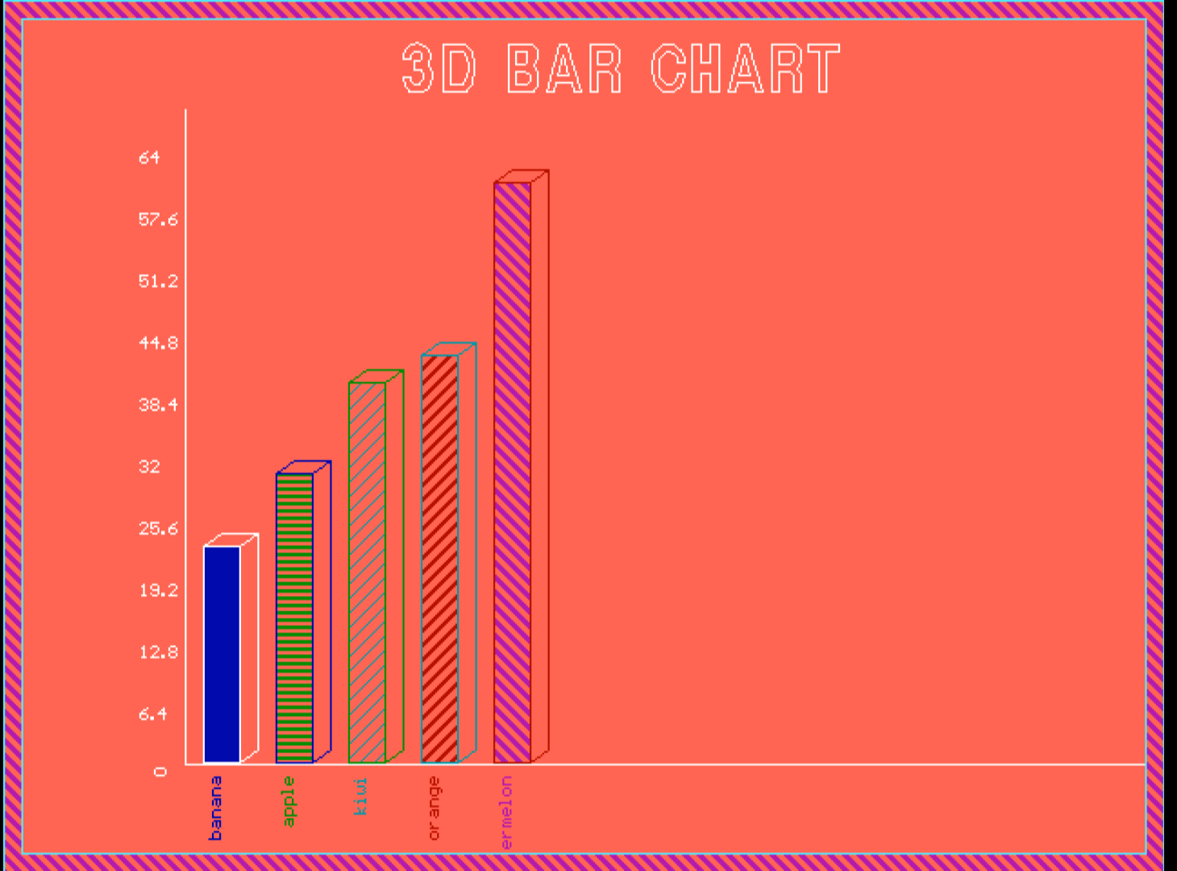
CG MINI PROJECT - GRAPH PLOTTER
BAR GRAPH AND 3D BAR GRAPH
User will provide data like production of fruits and Runs in different overs etc.
User will provide labels like fruit name or production of particular fruit in different years.
After that we will be adjusting the data for the proper graph SCALE to plot a correct graph.

Slide 7
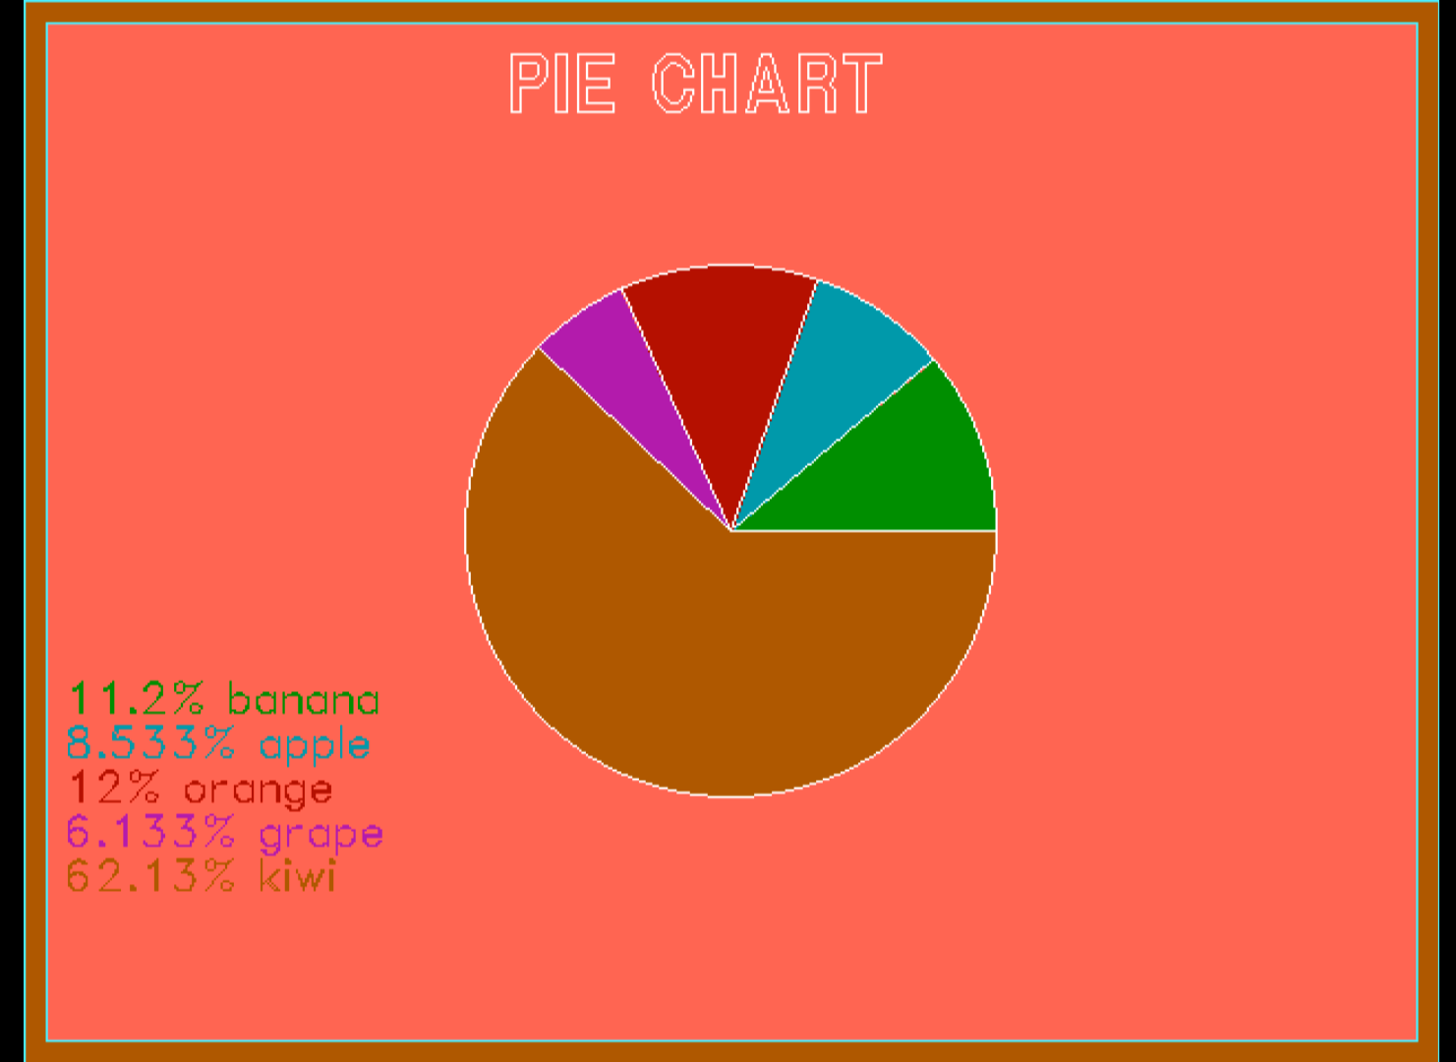
CG MINI PROJECT - GRAPH PLOTTER
PIE CHART
User will provide data like production of fruits and Runs in different overs etc.
User will provide labels like fruit name or production of particular fruit in different years.
After that we will be using “PIESLICE” function to represent pie chart and then calculating percentage of data allotted in chart and print that.

Slide 8
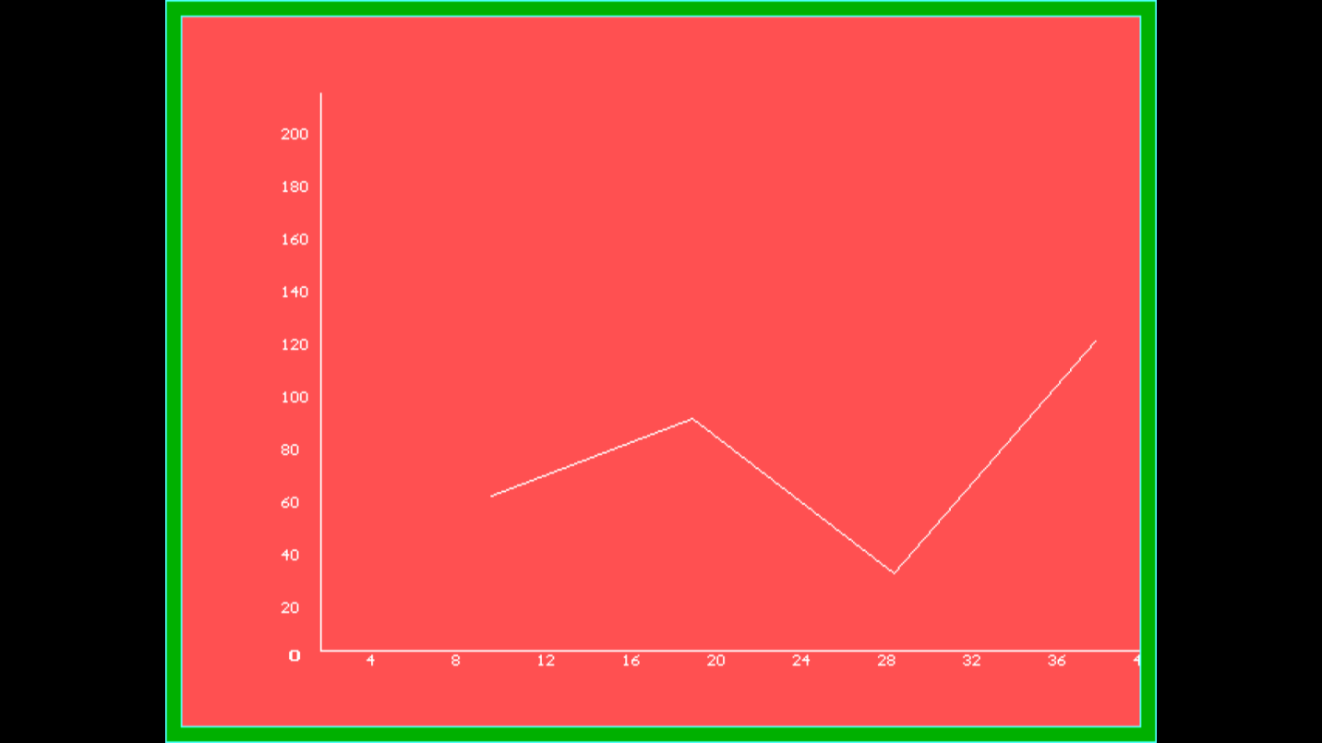
CG MINI PROJECT - GRAPH PLOTTER
LINE GRAPH
User will provide data for X-axis
User will provide data for Y-axis
Then we will be adjusting the SCALE to plot proper graph.

Slide 9

ENHANCEMENT
We can make it more flexible with different types of data.
Can make suitable for Float integer too.
Can also add more type of graphs.
Can make app or web apk.

Slide 10
Thank
You!
BY
Darsh Jain C17
Asjad Nirban C36

